Slide 1
Subject pronouns
Pronouns take the place of a noun.
Paul runs.
He runs.

Slide 2
Je
Tu
Il
elle
Nous
Vous
Ils
elles

Slide 3

To talk about yourself
I
Je

Slide 4
To talk to a friend or family member
you
tu

Slide 5
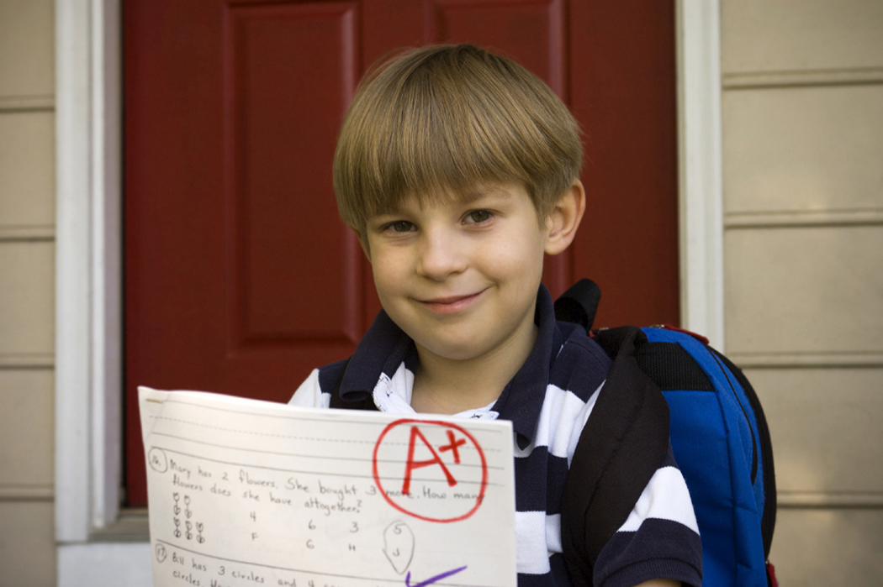
To talk about a boy
he
il

Slide 6
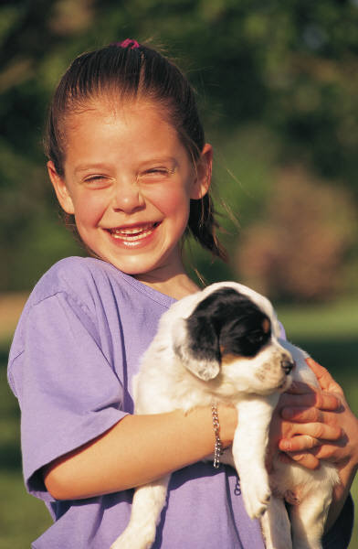
To talk about a girl
she
elle

Slide 7

To talk about yourself with others present
we
nous

Slide 8
To talk to more than one person
you
vous

Slide 9
To talk to an adult
you
vous

Slide 10
To talk about a group of boys –or a mixed group
they
ils

Slide 11
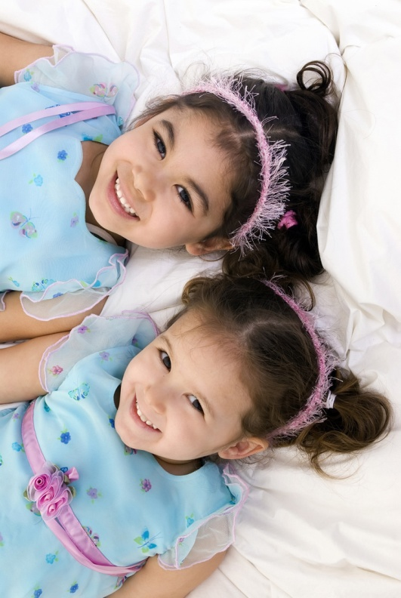
To talk about a group of girls
they
elles

